Slide 1
جامعة ديالى/كلية الهندسة
قسم الهندسة المدنية
تطبيقات حاسبة 1
المرحلة الثانية
البرمجة بلغة الفورتران
المحاضرة 6
إعداد:-
م.د.جنان لفته عباس
م.م. غسان منذر علي

Slide 2
المفكوك او المضروب Factorial
Example: write program to find the factorial of number N? n!=n(n-1)(n-2)….
Solution:
Program factorial
! program to find the factorial of number N
Implicit None
Integer:: N, fact, I
Fact =1
Print*, “input the number”
Read*, N
Do I=N,1,-1
Fact =fact*I
End do
Print*,”factorial=”,fact
End program factorial

Slide 3

المتسلسلة Series
Example(1): write program to find the value of e^{x} from the following series?
$$e^{x}=1+\frac{x}{1!}+\frac{x^{w}}{2!}+\frac{x^{3}}{3!}……..+\frac{x^{n}}{n!}$$
Solution:
Program Q1
Implicit None
Real:: x, E=1.0
Integer:: N, I, J
Print*,”input x, N”
Read*, x, N
Do I=1 , N
Fact=1
Do J=1,I
Fact=Fact*J
End do
E=e=x**I/fact
End do
Print*,”E=”,E
End program Q1

Slide 4

Example(2): write program to compute value of y from the following series?
$$y=4x+\frac{{100 e}^{x}}{2x}−\frac{{95 e}^{2x}}{5x}+\frac{{90 e}^{3x}}{8x}−\frac{{85 e}^{4x}}{11x}+………..\frac{{20 e}^{17x}}{50x}$$
Solution:
Program Q2
Implicit None
Real:: x,y
Integer:: A, I, K, J
Print*,”input x”
Read*, x
y=4*x
A=100 I=2
K=1
J=1
Do I=2, 50, 3 Do A=100, 20, -5
y=y+J*A*Exp(K*x)/(I*x)
K=K+1
J=-J
End do
Print*,”y=”,y
End program Q2

Slide 5

Example(3): write program to compute the value of Z from the following series?
$$Z=\frac{x}{2!}−\frac{x^{3}}{4!}+\frac{x^{5}}{6!}……..\frac{x^{9}}{10!}$$
Solution:
Program Q3
Implicit None
Real:: x, Z, Y
Integer :: I, J, K, fact
Print*, “input x”
Read*, x
K=1
Z=0
Do I=2,10,2
fact=1
Do J=1,I
Fact=fact*J
End do
Y=x**(I-1)/fact
Z=Z+K*Y
K=-K
End do
Print*,”Z=”,Z
End program Q3

Slide 6
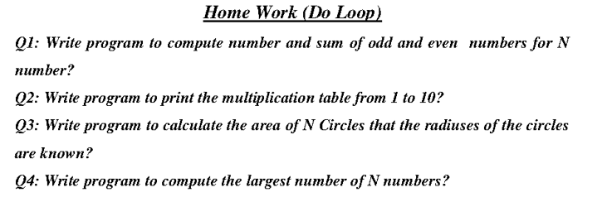

Slide 7
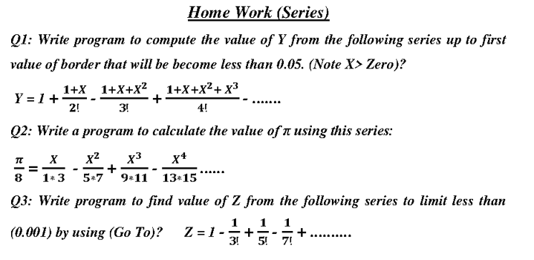


Slide 8
شكرا لأصغائكم

